Slide 1


Huron Research Suite Planning and Prioritization December 12, 2019

Slide 2

Agenda
Huron Production Support
SaaS structure
Implementation vs Support Phases
HRS Changes during Support Phase
Decision Criteria for Upgrade & Patches
Business Unit Participation
Huron Community Calls
Huron Enhancement Voting Website
Huron User Group (HUG) Annual Conference
GRIT Support
Next Steps

Slide 3
Goal of this meeting
To share knowledge of how the Huron Software as a Service model works for production support.
To design an agreed upon process to make decisions about sustaining, improving and growing the Huron Research Suite.

Slide 4
What to Expect In November - March
Operational Impact
Research Faculty
Department Administrators
HR Liaisons
Budget Directors
Office of Research
Office of Animal Welfare
Environmental Health & Safety
Institutional Review Board
Finance & Accounting
Human Resources
System Transformations
ARGIS to HRS Suite
HRS
PARIS
AURORA
PeopleSoft Financials
PeopleSoft HR
Campus Satisfaction
IMPLEMENTATION
STABILIZATION
1
Time
Trigger – HRS Grants, PS Grants, and HR Updates
Operational Stabilization
New Strategy, Vision, or Business Model
Adaptive Innovation
1
Short-term recovery with long-term restoration of growth and performance

Slide 5

SaaS Model
Software via subscription = Software as a service
Huron delivers 2 upgrades per year
Typically Spring and Fall
UCF cannot get more than 2 upgrades behind per contract
GRIT and Business Units will be expected to:
Participate in decision making for HRS updates
Test the upgrades
Participate in training
Review and modify existing business processes driven by software upgrades

Slide 6
Definitions
Support Case – Tickets opened with Huron to address bugs and enhancements. GRIT opens the support case based upon input from the business units.
Implementation phase – where Huron (Alan, Doug) have been making the changes on our behalf
By end of 2019, IRB, IACUC and Agreements will be closed in this phase. Grants will continue in this phase until the integration with PeopleSoft grants is complete.
Support phase – GRIT works directly with Huron via Support Cases to request administrative changes.
Self-Service Configuration Changes
Request for Configuration Changes
Upgrades
Patches

Slide 7
HRS Changes during Support Phase
Self-Service Configuration Changes
Changes that UCF admins (GRIT team) can complete without Huron
Currently includes updates to user roles, custom searches, minimal IT access for researching/troubleshooting
Huron continues to enhance this list of capabilities for SaaS clients
Requests for Configuration Changes – Per contract, one set of changes per month.
Examples - solution settings, help text, email notification templates, etc.
Upgrades
Huron releases 2 upgrades per year (Spring and Fall)
UCF does not have to take every upgrade, but we cannot get more than 2 behind
UCF Patches
UCF-specific changes outside of delivered solution (e.g. Open Issues lists)

Slide 8
HRS Changes – Upgrades & Patches
GRIT and Business Units will drive decisions to apply upgrades and patches
Planning and prioritization will be based on proposed criteria
Business Unit representation:
Chairs – Dorothy Yates, Ozlem Garibay, Debbie Reinhart
Business Units – Jennifer Shambrook, Celeste Rivera-Nunez, Michelle Greco, Mary Davis, Brenda Jackson, Jane Gentilini, Amber Thorne, Renea Carver, Gillian Bernal, Cristina Calcano, Doug Backman, Kim Smith, Joshua Roney
GRIT Team – Chad Macuszonok, Chris Meholic, Jen Bouvier, Christine Silver, Wil Cornelio, Nick Rufrano

Slide 9
Goals of this group
To support a transparent, open, inclusive and data driven process on how best to allocate resources, time, and funds to sustain, improve and grow the newly implemented Huron Research Suite.
The intention is to make decisions in the best interest of UCF and its research goals.
To ensure the proposed set of criteria are comprehensive to support decision making, and recognize they can change as needed. To view the criteria as guidelines for decision making.

Slide 10
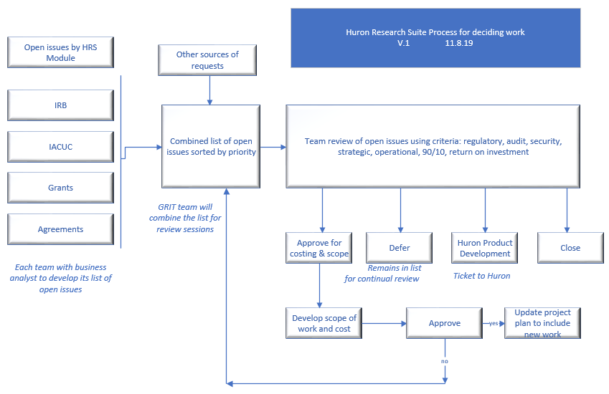
Decision Routing & Criteria

Slide 11
Proposed Criteria
Regulatory – Federal, state, local, accreditation
New compliance regulations
Audit – Findings or recommendations from audits
Segregation of duties
Security
Physical or cyber security
Strategic - Directives that have an institute-wide impact
Research 2020 250M
Operational - Necessary to sustain reliable and dependable systems
Vendor driven upgrades
90/10 Rule
Population impact versus cost
Return on investment
Increase PI satisfaction and service delivery

Slide 12

Business Unit Participation
Huron Community Calls
Monthly calls for each HRS module
Focuses on new/scheduled functionality and opportunities to provide feedback on future enhancements
Huron Enhancement Voting Website
Vote on most desired enhancements and provide comments with supporting business scenarios
Huron User Group (HUG) Annual Conference
April 27 -30, 2020 in Seattle, WA
Agenda includes:
Solution updates and HRS Roadmap
Solution-specific working groups
Cross-suite consistency working group
Product demos
https://click.huronsoftware.com

Slide 13

Production Support
GRIT Hours of Support
Monday through Friday, 8am - 5pm ET
Support team includes Christine Silver, Wil Cornelio, Nick Rufrano, Jen Bouvier, Chad Macuszonok
How to reach us?
GRITServiceDesk@ucf.edu
For urgent issues, please email Wahoo@ucf.edu
Urgent issues include site issues (unable to access site) and/or SF424 issues
Huron support team is in PT time zone, however they provide support during UCF’s business hours of 8am- 5pm ET.

Slide 14
Next Steps
Proposing this group meets quarterly to touch base
GRIT will meet with business units on a monthly basis

